Slide 1
INDUSTRIAL SPATIAL AUTHORIZATION
Αρχοντής Κοσμάς 1084020
Ασπιώτη Μαρία 1083881
ΗΜΤΥ- 2024

Slide 2



Η Startup μας
Mission Statement
ISAS Solution
To enhance safety, security and operational efficiency, and promote facility intelligence in high-tech manufacturing and industry.
Our Industrial Spatial Authorization System (ISAS) leverages IoT-enabled sensors and devices to provide a comprehensive, data-driven solution for tracking personnel, managing secure access, monitoring environmental metrics, and delivering real-time alerts within complex industrial facilities.

Slide 3
ΤΟ ΠΡΩΤΟ PROJECT

Slide 4
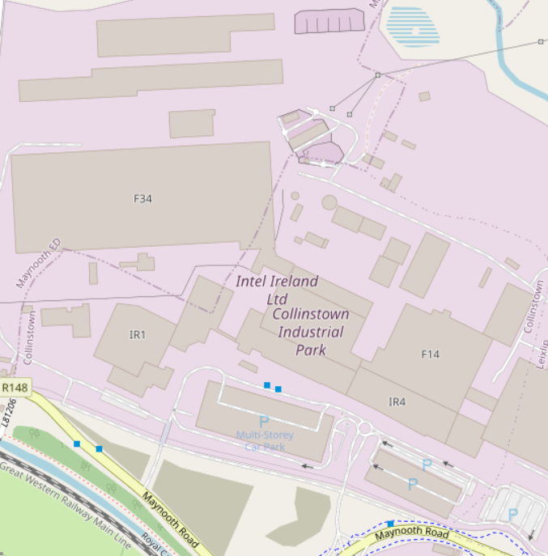
Intel Ireland
Leixlip
Collinstown Industrial Park

Slide 5
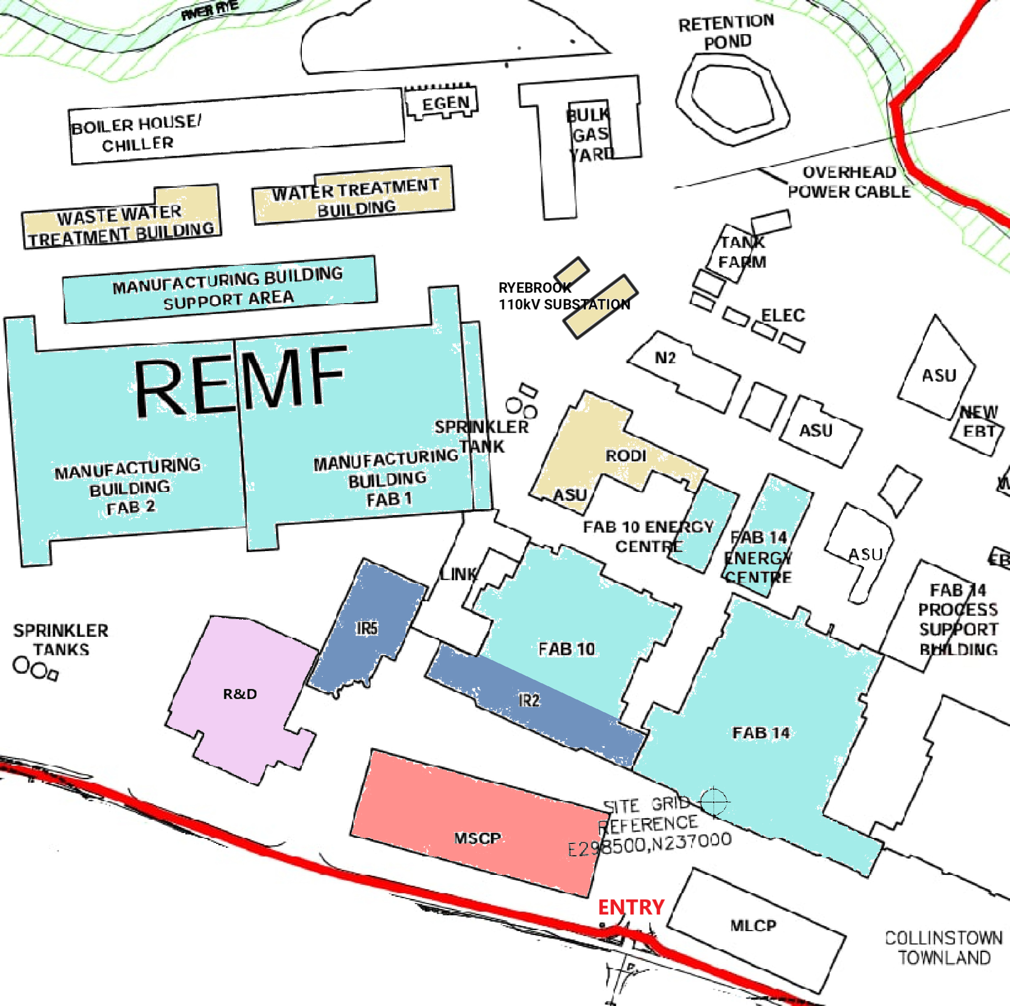
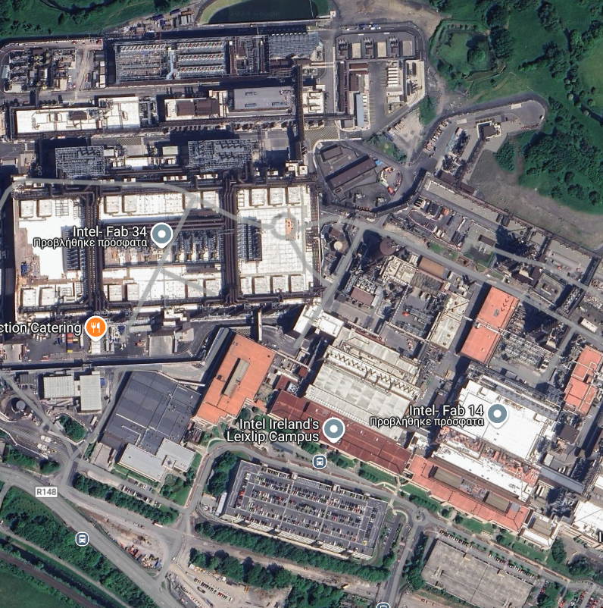



Slide 6
ΤΟ ΠΡΟΒΛΗΜΑ
Worker Safety
Securing Facilities – Access Control System
Facility Scheduling – Improper Entry
Evacuation & Emergency Protocols
Integrity of Sensitive Zones/Rooms – Environmental Control

Slide 7
Η ΛΥΣΗ
S.O.S. buttons
Worker Tracking – Historic View
Smart locks, locking down facilities/rooms
Alarms, Evacuation Path, Emergency Exits
Environmental and Working Conditions Monitoring

Slide 8

ΤΟ ΣΥΣΤΗΜΑ ΜΑΣ
Unified Security & Access Control System for Industrial Applications
Singular Dashboard – Unified Functions System
Specialized Monitoring for Areas of Interest

Slide 9

Ανταγωνιστικές Λύσεις
 | Siemens Desigo CC | Honeywell Forge | Cisco Spaces | Kantech (Tyco Sec.) | Our Solution
Worker Tracking
Access Control
Video Surveillance
Environment- Room control
Automation & Asset Management

Slide 10
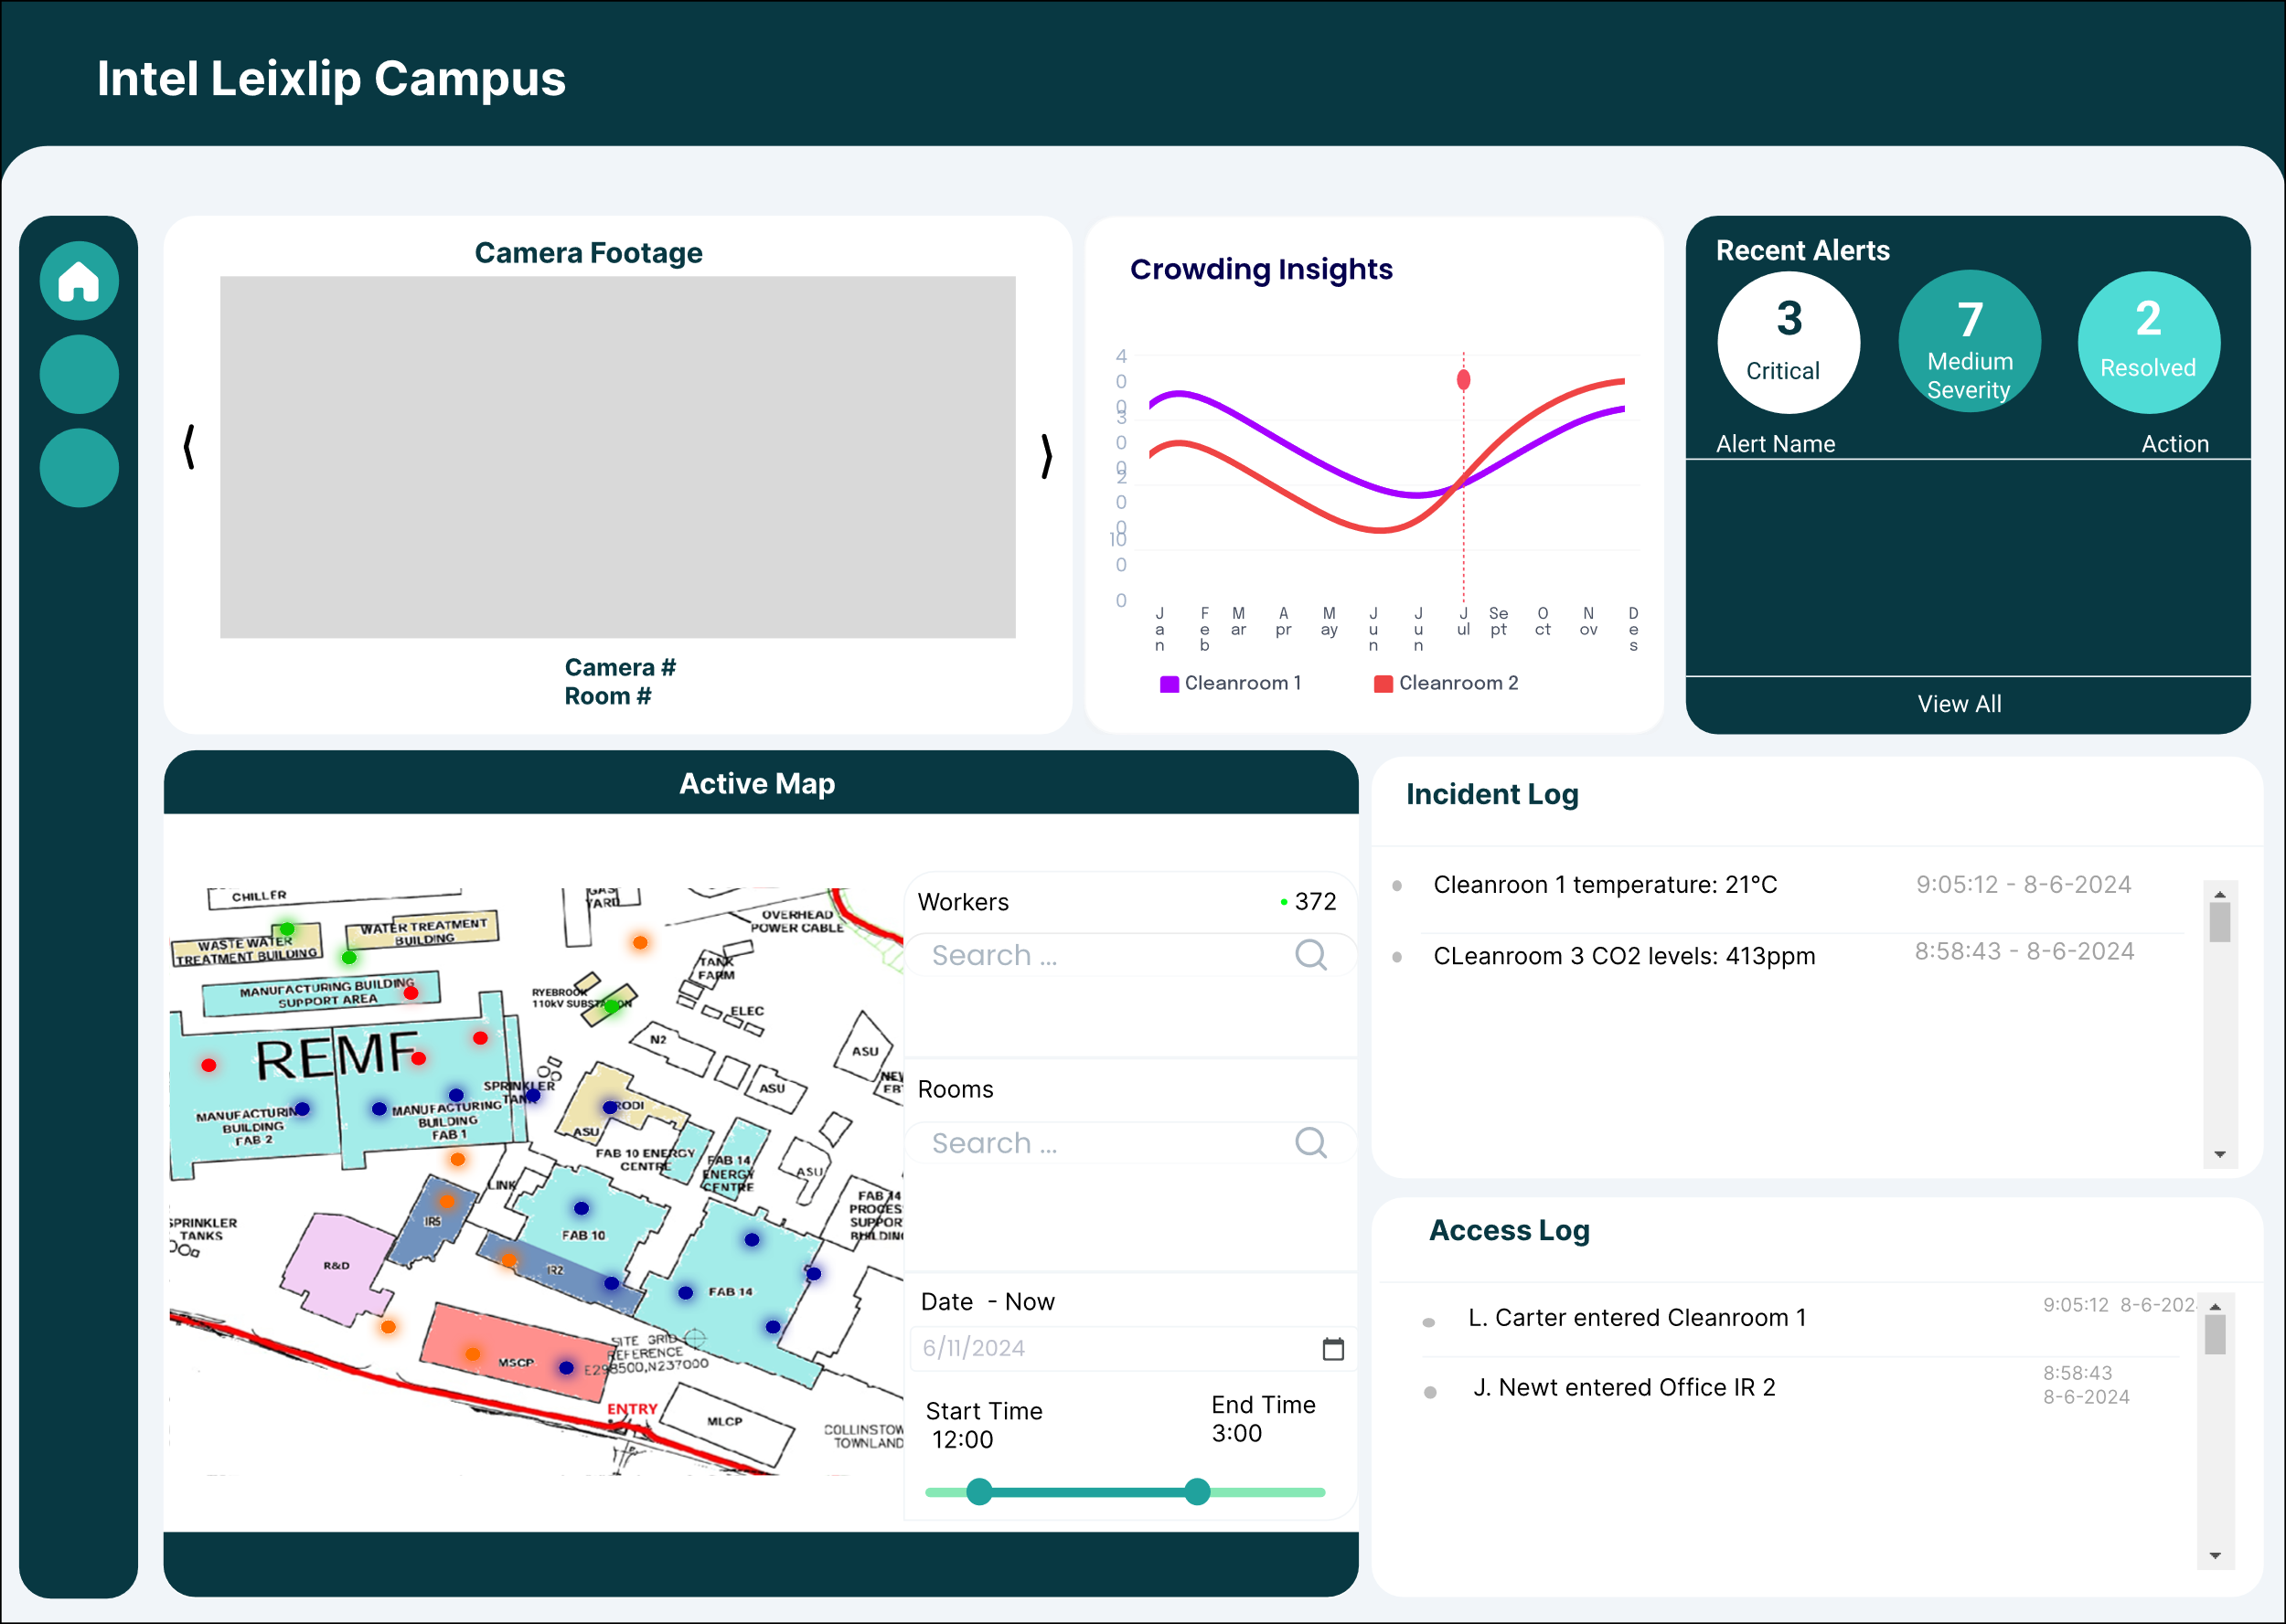
Dashboard Draft
Check last known location of a worker
Receive alarms, alerts, resolve incident
Check camera footage, sensor readings
View worker locations historically
Open/lock electronic doors
Schedule facilities
Metric | Measurement | Target | Actual
Audience attendance | # of attendees | 150 | 120
Engagement duration | Minutes | 60 | 75
Q&A interaction | # of questions | 10 | 15
Positive feedback | Percentage (%) | 90 | 95
Rate of information retention | Percentage (%) | 80 | 85

Slide 11
Devices & Equipment
Employees:
~1000 (4,900 in reality)
Facilities:
15 (>30 in reality)
Specialized Areas (Cleanrooms):
4 (~5 in reality)
(est. 1 for each fab)
BLE beacons, BT receivers
GPS trackers, LoRa Gateways
Cameras, Occupancy Measurement Sensor
SOS buttons
Smart locks, RFID tags/WiFi connectivity
Particle Counters, Light Intensity Sensors
Temperature, Humidity, CO₂ Sensors

Slide 12
Σε ποιον χρησιμεύει;
Multi-area complexes, where people tracking, asset monitoring is paramount
Facility Integrity and Access Control is critical
Specialized and unique facilities with high demands for security and control
Industrial Contexts – Manufacturing Complexes
Educational/Corporate Campuses
Healthcare Facilities – Patient Monitoring

Slide 13
ΕΥΧΑΡΙΣΤΟΥΜΕ

